Slide 1


Team Name: Lunar Legends
Name of College(s)/University(s): Chandigarh University
GitHub Link : https://github.com/aastha0424/voice-enabled-gis
Team Members Details:
Aastha Singh
Anjali
Khushi Singh Rajpoot
Ishani Jauhari

Slide 2

Project Approach
The goal of the Voice-Enabled GIS project is to create a web application where users can control map features and access geospatial data through voice commands. The application uses OpenLayers to display maps and integrates various speech recognition solutions to interpret and execute voice commands.
Development Approach:
Prototype and Testing:
We have started with a basic version of the WebApp that focuses on core functionalities like map display and voice commands. Testing will help us find the best speech recognition solution.
Incremental Development:
We have gradually started to add features, starting with the most essential ones. Each new feature will be tested and refined.
User Feedback:
We’ll gather feedback from users to improve usability and accuracy. Adjustments will be made based on these feedbacks.
Documentation and Deployment:
We have started documenting the code, features, and APIs used. Before deploying, we'll ensure the application is optimized for performance and scalability.

Slide 3






Tools and Technology Used
Programming Languages: Python , JavaScript
GIS Libraries: OpenLayers
Machine Learning Frameworks: TensorFlow.js
Voice Recognition APIs: SpeechRecognition (Default Engine: Google Speech API ), pyttsx3
Mapping and Data Services: Bhuvan (ISRO), NASA Worldview, OpenStreetMap
Web Technologies: HTML , CSS , JavaScript
Server: WebSocket
Data Formats: JSON, WMS layers
IDE: Visual Studio Code (VS Code) - Used for code development and debugging.
Version Control: GitHub - Manages code repositories and version control.

Slide 4
The Uniqueness of Our Idea
Hands-Free Interaction: Users can navigate and interact with the map using voice commands, enhancing accessibility and convenience, making the system more user-friendly.
Points of Interest (POI) Layers : The map highlights various important locations and landmarks, making it easier for users to find places of interest.
Weather Information : The system provides real-time weather updates for any location, ensuring that users are always informed about current weather conditions.
Air Quality Information : Displays real-time air quality data, allowing users to monitor and assess environmental conditions in different areas.
Natural Disaster Monitoring : The system monitors and provides alerts for natural disasters, such as floods, earthquakes, and wildfires, helping users stay informed and prepared.

Slide 5

Detailed solution : Project Overview
The Voice-Enabled GIS (Geographic Information System) application integrates voice recognition with a GIS platform to allow users to interact with maps using voice commands. The application supports various map layers and functionalities, enabling users to switch map views and access information through spoken commands. The application is built using OpenLayers for the GIS interface, TensorFlow.js for handling machine learning tasks, and a combination of speech recognition and WebSocket technologies for real-time voice interactions.
Objectives
Voice Interaction: Enable users to control and interact with the GIS application using voice commands.
Dynamic Map Switching: Allow users to switch between different map layers (e.g., satellite view, terrain view) using voice commands.
Real-Time Communication: Implement real-time communication between the client and server to handle voice commands and provide feedback.

Slide 6
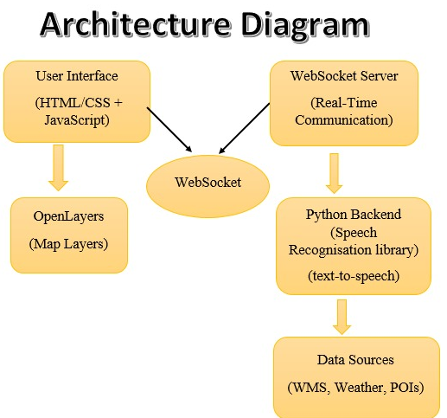

Slide 7
Detailed solution : Project Architecture
Frontend:
HTML/CSS:
Create the structure of your webpage, including areas for the map, voice command button, and any additional UI elements.
JavaScript:
OpenLayers: Implement and manage map layers and views. Handle user interactions and commands.
Voice Control: Use JavaScript to send voice commands to the WebSocket server and process responses.
Backend:
WebSocket:
Manage real-time communication between the client and server. Handle the transmission of voice commands from the frontend to the backend and vice versa.
Python:
Speech Recognition: Use the speech_recognition library to convert voice commands to text.
Text-to-Speech: Use pyttsx3 for providing auditory feedback to users.
WebSocket Handling: Implement WebSocket server logic with asyncio to handle incoming commands and communicate with the frontend.

Slide 8
Detailed solution : Key Features
Voice Commands:
Switch between different map views (e.g., satellite, terrain, standard, Relief).
Provide feedback on the command being processed.
Working on to include more features like weather information, natural disaster monitoring , air quality information, and Points of Interest (POIs)
Map Layers:
Standard Map: Provides basic map view.
Relief Map: Shows enhanced topographic features.
Terrain Map: Displays terrain with elevation details.
Satellite Map: Offers high-resolution satellite imagery.
Bhuvan Land Use Land Cover: Displays land use and cover information.
More Maps: As we add more features, additional map layers will be incorporated to provide even more detailed and varied information.
Real-Time Feedback:
Notify users when the system is actively listening for commands.
Provide verbal feedback on recognized commands using text-to-speech (TTS)
WebSocket Communication:
Establish a WebSocket connection for real-time communication between the client and server.
Handle incoming voice commands and broadcast responses to connected clients.

Slide 9
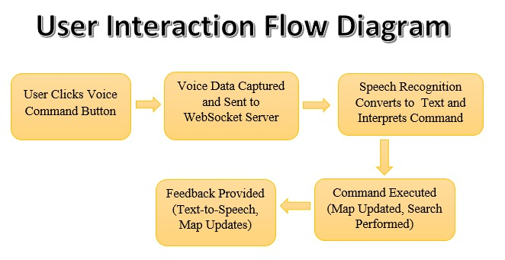

Slide 10
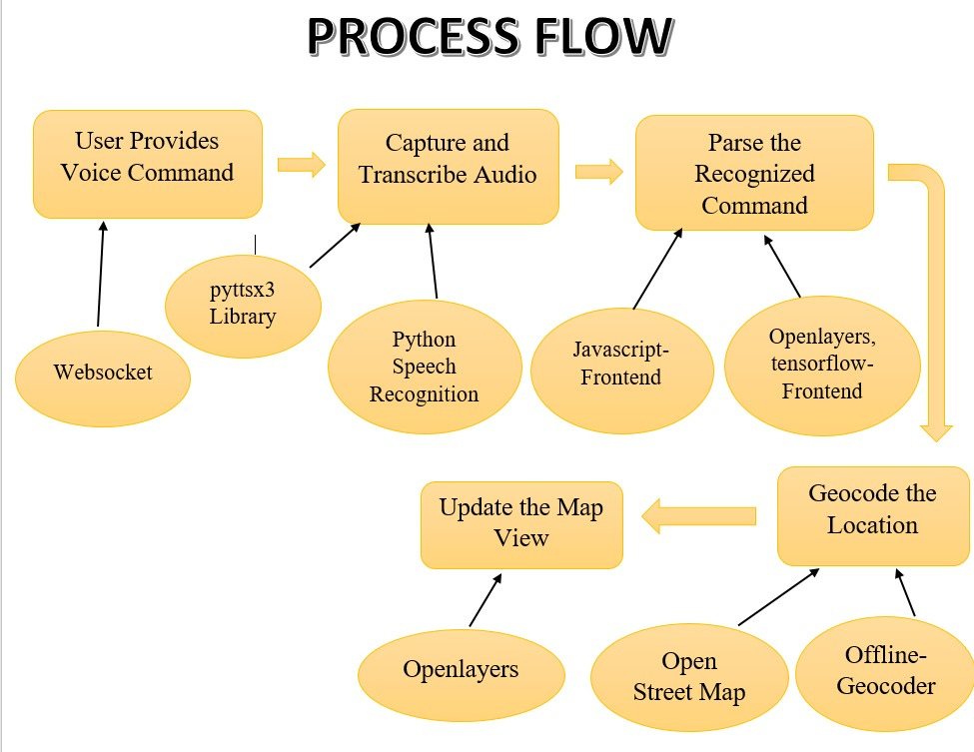
Process of Geocoding a Location

Slide 11

Potential Impact of Your Solution
Voice Commands: Enables users to interact with the GIS application through voice, making it accessible for those with visual impairments or limited mobility.
Real-Time Data Access: Provides quick access to geospatial data and map layers with voice commands, reducing the time required for manual navigation.
Integration with Various Data Sources: Supports integration with data from Bhuvan ISRO, NASA Worldview, and other GIS platforms.
Offline Functionality: Ensures continuous operation even without internet access, making it reliable in remote or underdeveloped areas.
Broad Applications of the Voice-Enabled GIS Solution : The solution supports disaster management by enabling hands-free access to critical information, aids urban planning with efficient data analysis, and enhances tourism by providing voice-driven insights into points of interest and routes.

Slide 12

Future Enhancements
Advanced Features:
Integration of weather data, traffic updates, and natural disaster information.
Support for additional languages and accents for voice commands.
User Interface Improvements:
Enhanced map layer customization and control options.
More intuitive voice command interface and user feedback mechanisms.
Scalability and Performance:
Optimize server performance to handle larger numbers of simultaneous connections.
Improve voice recognition accuracy and response times through ongoing improvements.
Tourist Attractions Enhancement:
Expand tourist attractions feature to include detailed information, images, and user reviews.
Provide recommendations based on user preferences and location.

Slide 13
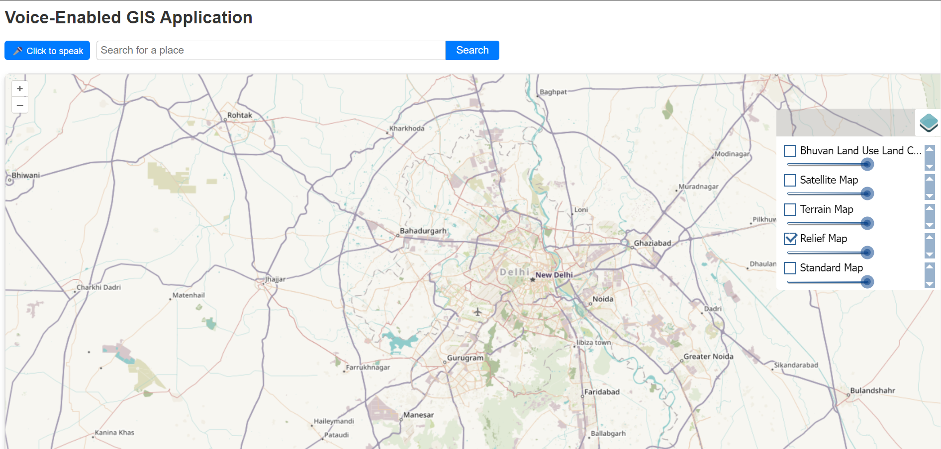
Basic Prototype

Slide 14
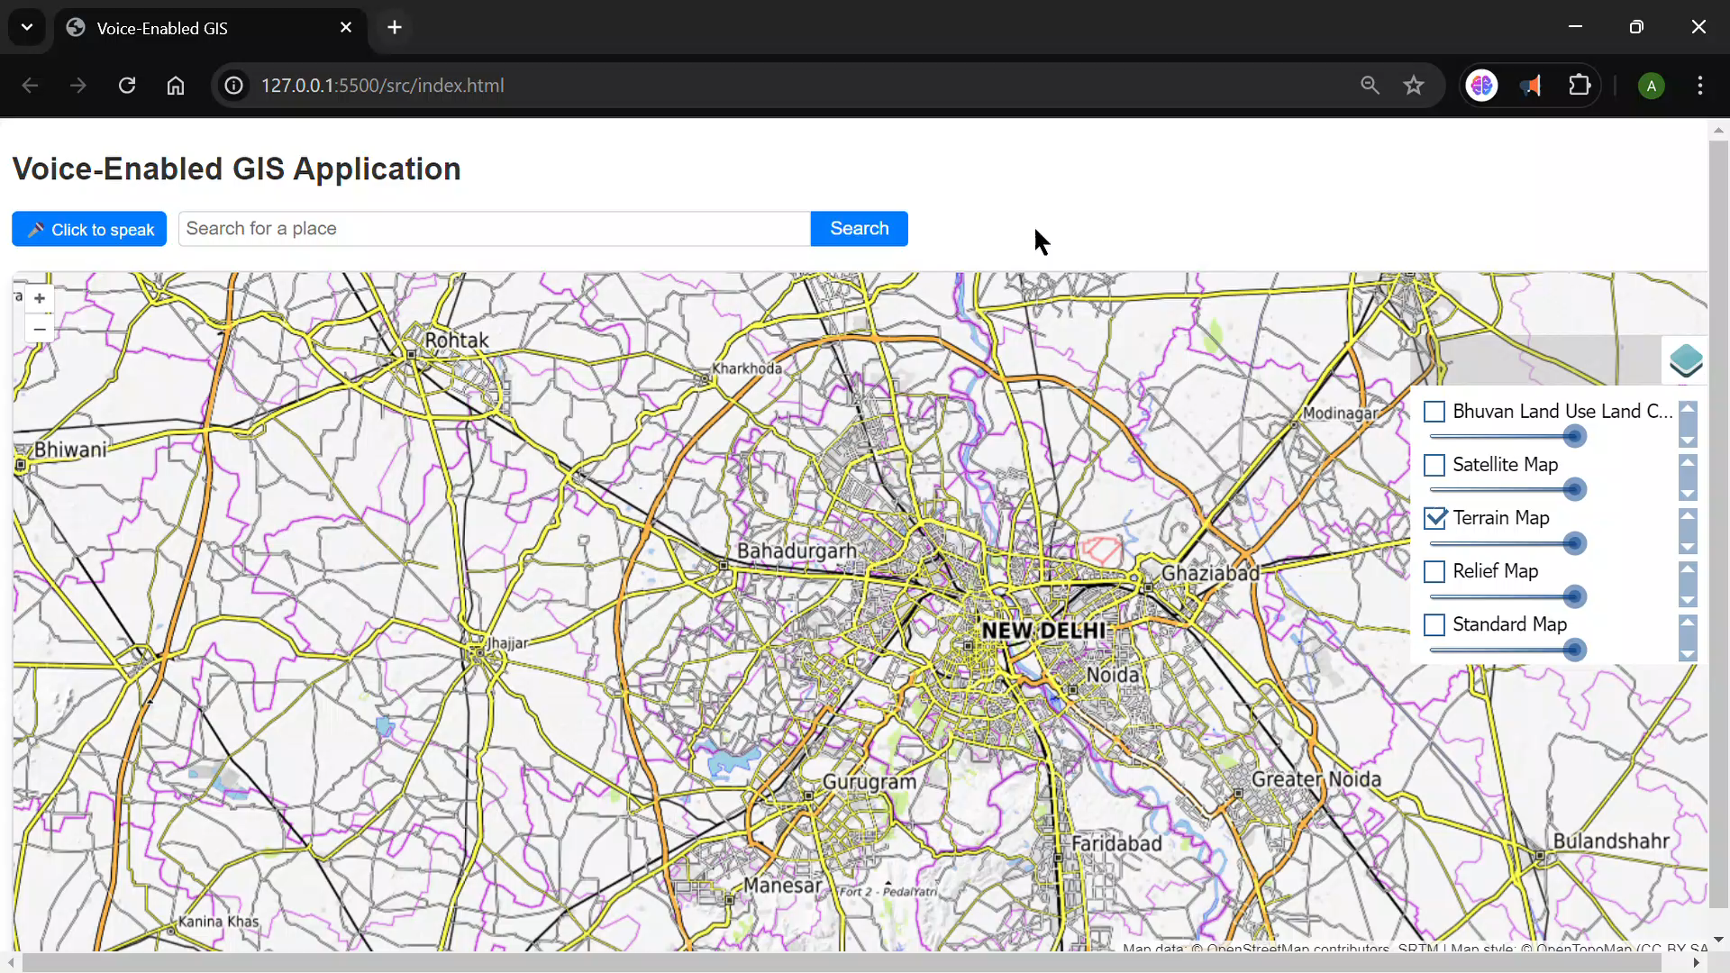

Slide 15
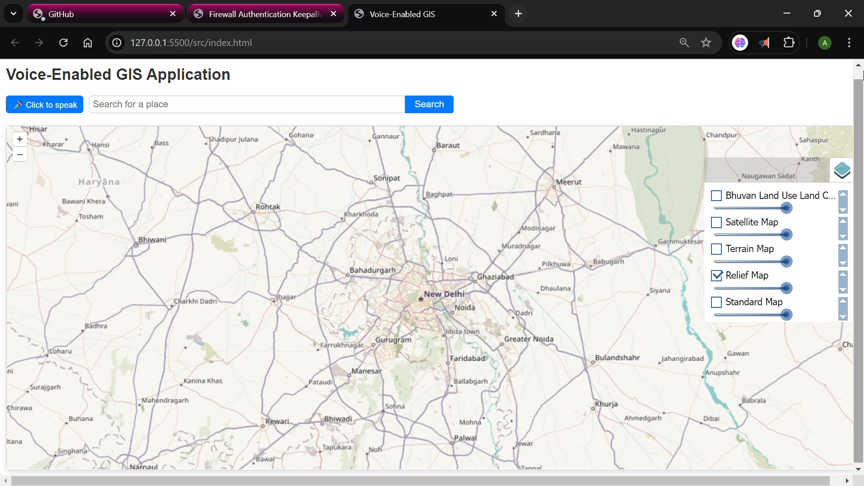

Slide 16


